Slide 1
Jeopardy
Cognitive
Distortions
Stress
& Wellness
Cognitive
Coping
Emotional
& Social
Resiliency
100
100
100
100
100
200
200
200
200
200
300
300
300
300
300
400
400
400
400
400
500
500
500
500
500
Final Jeopardy

Slide 2
Cognitive Distortions - 100
This is what we are doing when we say “always” or “never”
Overgeneralization

Slide 3
Cognitive Distortions - 200
When a person predicts the future, they are…..
Jumping ahead to conclusions

Slide 4
Cognitive Distortions - 300
This thought pattern fosters perfectionism
All-or-nothing thinking

Slide 5
Cognitive Distortions - 400
A person who takes responsibility for events beyond their control is doing this….
Personalization

Slide 6
Cognitive Distortions - 500
This occurs when a person blows a small event out of proportion
Magnification

Slide 7
Stress - 100
This term describes a situation who appears very active but is unable to think and plan well
Go-No Response

Slide 8
Stress - 200
In this phase of stress, a person is generally dissatisfied and finds both home and work life draining
Phase 3: Withdrawing

Slide 9
Stress - 300
Knowing the phases of stress can alert us to when we may be experiencing…..
Chronic stress

Slide 10
Stress - 400
In this mode of operation we shut down, are depressed and lack energy
No-No response

Slide 11
Stress - 500
Someone who avoids certain tasks and has poor concentration may be in this phase of stress….
Phase 2: Becoming Disillusioned

Slide 12
Cognitive Coping - 100
This strategy involves recasting your experiences in a positive way.
Reframing

Slide 13
Cognitive Coping - 200
The second step in decision making is…
Look at options

Slide 14
Cognitive Coping - 300
Be sure to carefully consider this when choosing your best option
The outcomes of taking action

Slide 15
Cognitive Coping - 400
This step of reframing includes looking for repeat patterns of unhealthy thoughts
Step 3: Analyze the situation

Slide 16
Cognitive Coping - 500
If we can choose our perspective, we can create more of this….
Choice

Slide 17
Emotional & Social - 100
This enables us to tune in to emotions and focus our attention on what we need.
Awareness

Slide 18
Emotional & Social - 200
Taking this action is a powerful part of self-care.
Making choices about who and when we connect with others

Slide 19
Emotional & Social - 300
This strategy includes learning to say no or yes from a clear and congruent stance.
Setting boundaries.

Slide 20
Emotional & Social - 400
This strategy is built on full honesty with ourselves, and expanding our respect for our true fears, strengths, vulnerabilities and dreams.
Self-kindness.

Slide 21
Emotional & Social - 500
A key ingredient to our overall wellness is…
A healthy social support net.

Slide 22
Resiliency - 100
Co-dependent (or enabler)
  Families with addictions class

Slide 23
Family Crises - 200
What kind of external boundary is common in families with either addictions or violence?
Closed
  Unit 7 classes & online lecture

Slide 24
Family Crises - 300
The nurse suspects intimate partner violence, but the client denies it. What 2 things should the nurse do?
Comment on discrepancies in injury & history
provide information
document the client’s response
make a follow-up appointment
  Family violence lab activity & handouts

Slide 25
Family Crises - 400
Which of the childhood “survival roles” is most at risk to become a co-dependent adult?
The hero
  Addictions class: based on understanding of these two roles – both roles involve “rescuing” others

Slide 26
Family Crises - 500
Screening for family violence on the orthopedic unit is an example of which level of prevention?
Secondary prevention (problem or risk factors already present)
  Reading by Landenburger et al for family violence class/lab

Slide 27
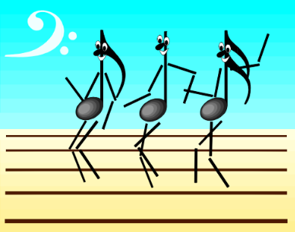
Final Jeopardy
How did health professionals misinterpret family-centred care in the study by McKean et al Required reading for Med-Surg)?
They shifted responsibility to parents instead of working with them as partners
They did not negotiate roles with parents, but assigned roles instead
  Required reading for Unit 6: class with guest speakers

